Slide 1


Brain Tumor Detection & Diagnosis
CNN & PyTorch
Presented by P_MLSpecialist

Slide 2


Brain Tumor Detection Model
Deep learning is a powerful tool in medical imaging for brain tumor detection and diagnosis. It analyzes MRI or CT scans with high accuracy and efficiency, classifying tumors into different types. This improvement in classification enhances treatment planning and patient outcomes.
Manual interpretation of medical images can be time-consuming and subjective, leading to errors and delays. This project aims to develop a Convolutional Neural Network (CNN) using PyTorch to accurately detect and classify brain tumors from MRI scans. Through training on labeled data, CNN will enhance tumor detection and classification, thereby improving efficiency and accuracy.

Slide 3
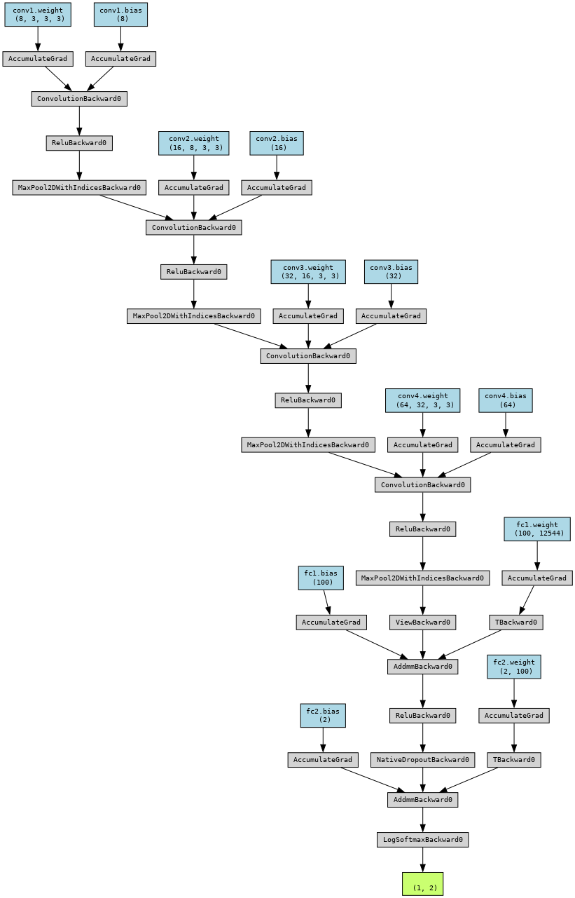
Methodology used in the training
----------------
Structure of Brain Tumor Model

Slide 4
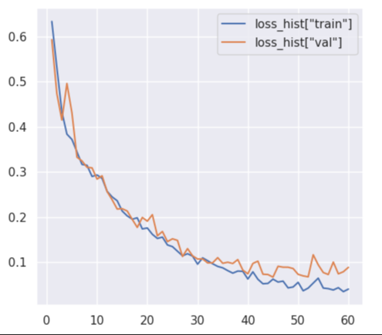
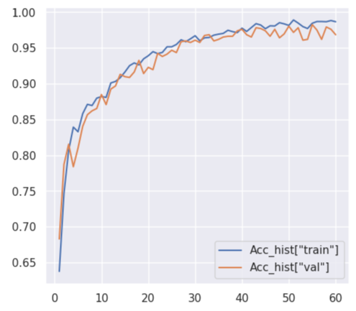
Comparison of Lass & Acc in Training and Validation steps

Slide 5
98%
F1_Score, Accuracy
Finally, the Brain Tumor Detection Model that we trained with F1_Score and Accuracy of %0.98 can detect brain tumors from MRI and CTS-scan images.

Slide 6

Thank you very much!
Contact me by :
P.K.MLSpecialist@gmail.com

